Slide 1

IPaT Fall Town Hall
Aug 21, 2015

Slide 2

Welcome: Steve Cross EVPR

Slide 3
IPaT Highlights
Infrastructure for Healthcare Transformation:
interoperability + HPC + Data + Analytics Support
ERC and Major Research Proposals
GA STEM Event co-hosted with TAG
Wearable Computing Forum
GT Informs PCAST Report on Aging and Technology
GT Civic Computing Living Labs Presented at HCII 2015
Midtown Buzz, Cycle Atlanta, GT Journey, CIC and Argon

Slide 4
IPaT Fall Schedule
IPaT Town Hall Aug 21
Wearable Computing Forum Oct 21
GVU++ Research Showcase Oct 21
Convergence Innovation Nov
Competition
Mini Office Hours Nov
Annual Holiday Luncheon Dec
Thursday Think Tanks
Thursdays, 3:30-5
IPaT All Hands Aug 13
IPaT Research Directors
Sept 1, Sept 29, Nov 9, Dec 2
8:30-10 am
IPaT 5 Year Review Oct 28-29
Campus Advisory Board Nov

Slide 5
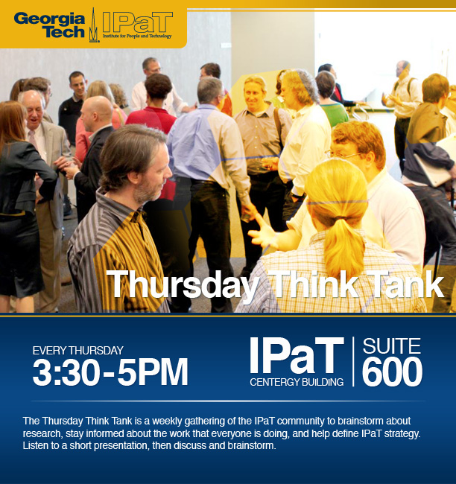
Thursday Think Tanks
The TTT is a weekly gathering
of the IPaT community to brainstorm about research,
stay informed about the work that everyone is doing, and
help define IPaT strategy.
Come interact with new and old colleagues and engage on topics of shared interest.

Slide 6
Thursday Think Tank Thursdays, 3:30-5pm
Schedule
Topic | Date
Welcome Back & Networking | Sept 3
Minecraft Atlanta Initiative: Brainstorming | Sept 10
Evidence-based Entrepreneurship | Sept 17
Connected Living | Sept 24
Pediatric Initiatives & CTPHD | Oct 1
IoT: Feedback from Industry | Oct 8
Wearables in the Wild | Oct 15
External Relationships | Oct 22
Georgia STEM Accessibility Alliance (GSAA) and its use of virtual worlds for e-mentoring | Nov 5

Slide 7

IPaT Summer Planning
Start with campus level research aspirations
Generate shared research goals
Frame goals in the context of resources and processes
Generate shared dept goals
Update dept plans and processes
Communicate back to campus

Slide 8
IRI Overarching Goals
Thought Leadership and External Partnership | Organize and articulate (inter)national thought leadership Enable the creation of funding ops through leadership in the dev of national and state science and tech priorities Coordinate w/ GTRC and EI2 on economic dev activities Focal pt for interaction with external partners
Internal Coordination and Facilitation | Catalyze new research directions, maintain a dynamic research portfolio and facilitate the formation of interdisciplinary teams Coordination research efforts with colleges, schools, IRCs, CTRs & GTRI Support multiple IRCs and CTRs Be an inclusive research organization Communicate the broad research vision to all members
Resource and Facility Mgmt | Facilitate the use of shared resources (personnel and physical) Manage / support research space and facilities Provide staff support and other resources to facilitate the development of large-scale, multi-investigator extramural grant proposals Provide seed funding opps for new research ideas

Slide 9
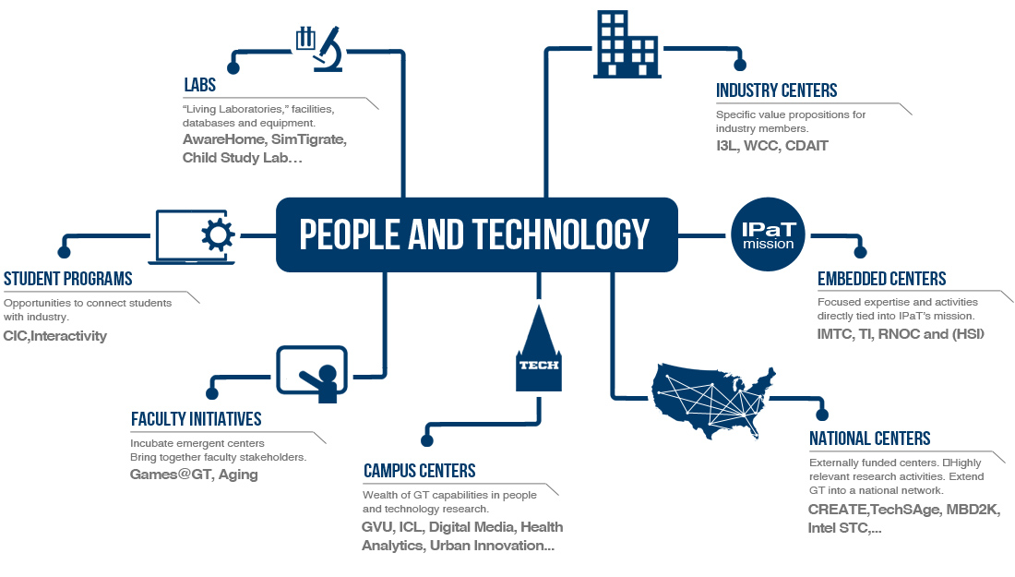
Supporting our GT Network

Slide 10
GVU–IPaT Innovation & Engagement Grants
Reimagining Humanities Visualization: A Research-Through-Design Workshop for Civic and Cultural Data
Carl DiSalvo, Nassim JafariNaimi, Lauren Klein, Yanni Loukissas (LMC)
Rahul Basole, Alex Endert, Jim Foley, John Stasko (IC)
Polo Chau, Jimeng Sun (CSE)
Promoting Cognitive Systems Research at GT with additional support through GTRI
Ashok Goel
Elizabeth Whitaker
Real-Time Control to Replace Schedules on the Atlanta Streetcar with additional support through the Center for Urban Innovation
Kari Watkins, CE
Russ Clark, CS and RNOC
Applying Design Studio Pedagogy in STEM Learning with Novel Presentation and Sensing Technologies
Betsy DiSalvo, IC
Mark Guzdial, IC
Blair MacIntyre, IC

Slide 11
CTPHD (Pediatric) Seed Grants
Determination of the Appropriate Level of Preventive Dental Services for Children by Risk Status and Special Healthcare Needs
Paul Griffin, Ph.D. GT ISyE
Jack Thomas DDS, PC CHOA
Nicoleta Serban, Ph.D. GT ISyE
Transforming Pediatric Heart Transplant Rejection Care Using Integrated Analytics for Precision Medicine
John H. Phan, Ph.D. GT
May D. Wang, BME GT/Emory
William T. Mahle, M.D. CHOA
Kevin Maher, M.D., CHOA
Ajay Bhatia, M.D., Ph.D. CHOA

Slide 12
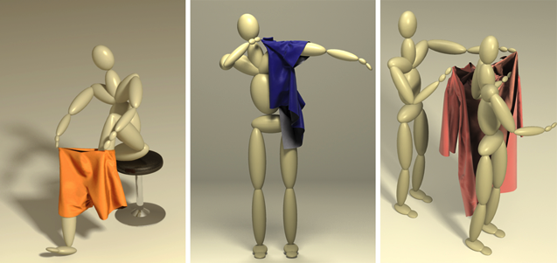
Seed Grants lead to bigger and better things…
Lauren Wilcox and Steven Simoneaux
2014 CHOA seed grant “Utilization of Diagnostic Radiology Reports by Pediatric Patients’ Family Members”
Led to $175K 2 year NSF Smart Health grant on “Novel User Interfaces for Reporting Personal Health Information”
Karen Liu, Greg Turk and Charlie Kemp
2013 seed grant ”Simulating Activities of Daily Living: Dressing Clothes”
Led to $1.2M 4 year NSF grant on “Robotic Assistance with Dressing using Simulated Optimization”
And 2015 SIGGRAPH paper on “Animating Human Dressing”

Slide 13
IPaT “Office Hours” Research Survey
Proposal Support
Research units at other universities
Large proposal support
Collect unfunded proposals
Review panel vantage points
Research Infrastructure
Shared services
Mobile health
Data needs
Marcom
Unending appetite
Development Support
Pre-commercial sw & hw
Publishing mobile apps, tools
IMTC mission
Academic + GTRI + EI2
People Support
Research scientists
Craftsman in residence
Research Connections
Media + Health + Humanitarian + …
Extend to policy / white papers
Socio-Technical Systems

Slide 14
IPaT Research Priorities
Wearable Computing
Civic Computing and Urban Innovation
Pediatric Healthcare Delivery
Healthcare Transformation
Humanitarian Systems and Disaster Response
Successful Aging

Slide 15
Wearable Computing Center

Slide 16
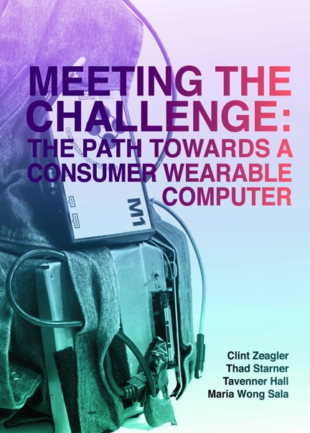
Wearable Computing Center
IRC proposal submitted
Wearable Exhibition
  E-Book now available
WCC Forum, Oct. 21
  Engagement Grants planned
WCC themed Think Tanks
Research Activities
  Instinctual Computing
  Agriculture, Sports, Health, Apparel, Automotive
  Google, Sharecare, BMW, GA Dept Ag, Coaches Studio, Carters, Sunjewels…

Slide 17
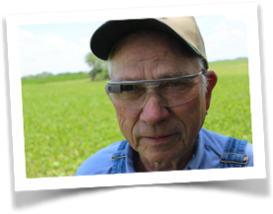
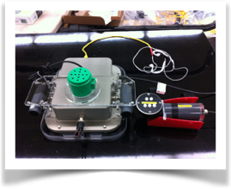
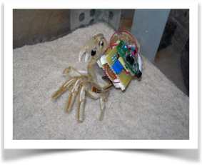
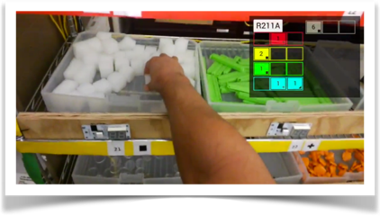
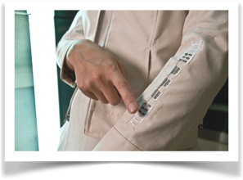

Slide 18


Christopher Le Dantec
Assistant Professor, School of Literature, Media and Communication
Thomas Lodato
Post-doctoral Fellow, Center for Urban Innovation, School of Public Policy

Slide 19
How do we shape smart, innovative cities?
It starts by engaging scholars and community leaders—researchers, students, civic and business executives, and more—to share approaches to problem solving in an innovative, cross-sector conversation.
Notes:
Georgia Tech’s Center for Urban Innovation (CUI) thinks globally and acts locally by investing in interdisciplinary, scholarly research on urban issues and the expanding role of institutions in designing and governing resilient regional economies.
Uniquely positioned within a world-leading technological research university and a global city, CUI was launched in 2014 to pursue research-driven discoveries that solve problems faced by cities and regions internationally.
Together, CUI and our partners—Georgia Tech faculty, universities around the country, nonprofits, civic organizations, public agencies, and tech industry businesses—prove the value of investment in collaborative research to drive innovation in stakeholder communities on the local, national, and international level.

Slide 20
What we do:
Conduct and support interdisciplinary, scholarly research on urban innovation
Foster partnerships within Georgia Tech and other universities, nonprofits, and public agencies to collaborate on strategies for creating sustainable communities
Share Georgia Tech’s urban innovation expertise with the stakeholder community locally, nationally, and internationally
Notes:
We are advancing the urban innovation conversation.

Slide 21
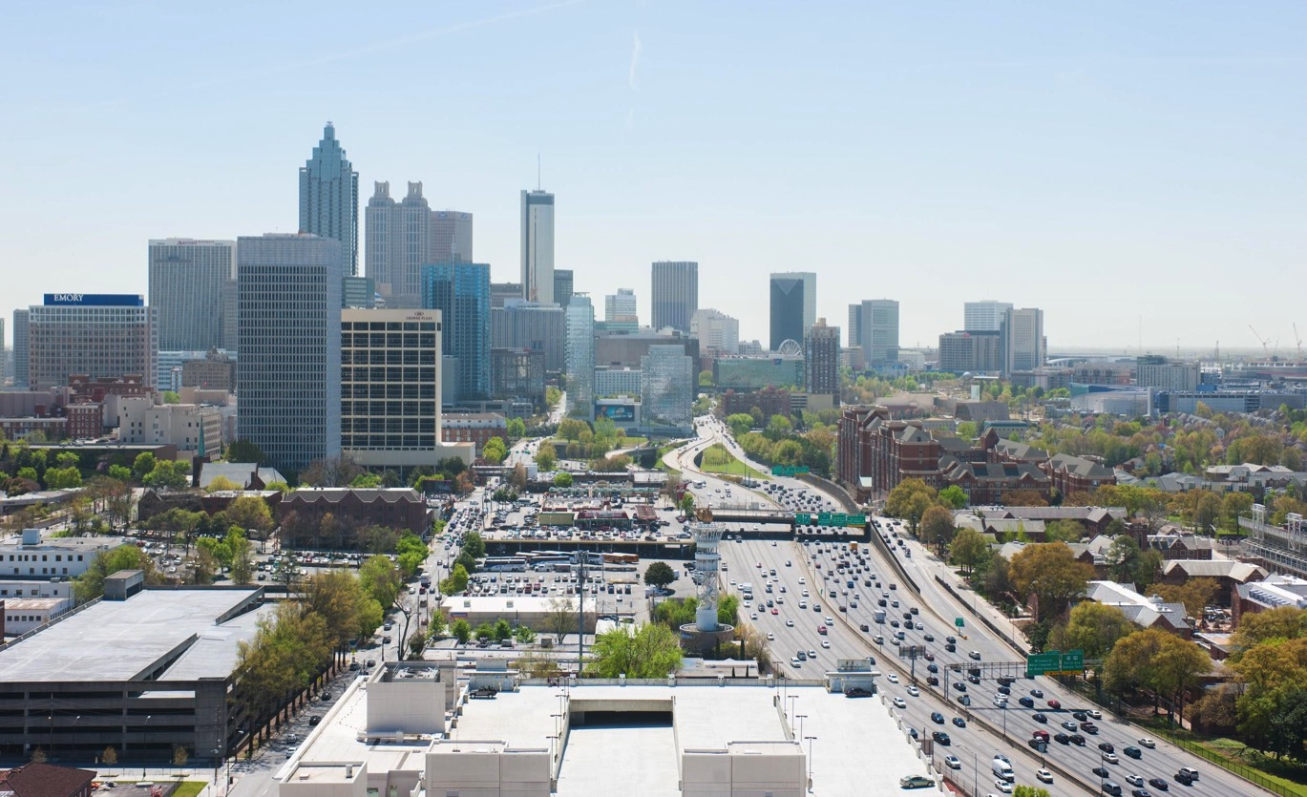
CUI is Leading

Slide 22
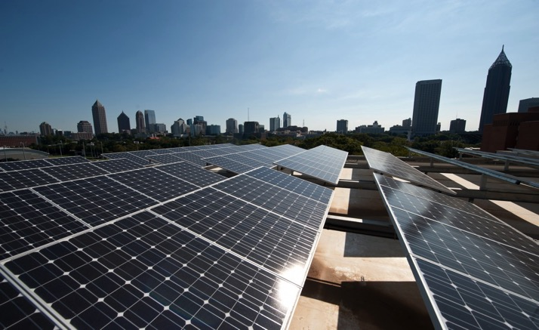
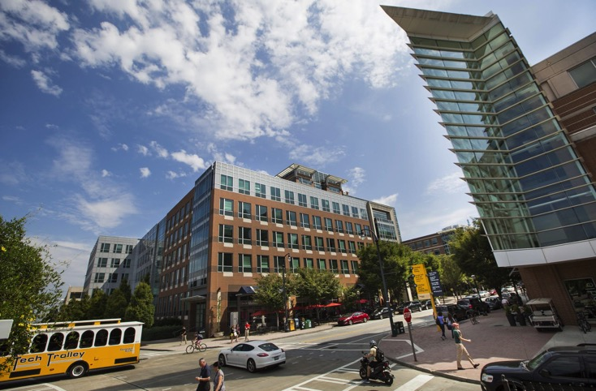
Innovation Districts
Highlighting Tech Square’s innovation ecosystem in Putting Innovation in Place: Georgia Tech’s Innovation Neighborhood of “Tech Square,” CUI is codifying and sharing the “Atlanta model” with other urban universities and internationally.
Sustainable Cities
CUI is facilitating intersecting nodes of layered research, by connecting a $2.5 million NSF-funded civil and environmental engineering project with policymakers in ten cities through the City Energy Project, including the City of Atlanta’s Office of Sustainability.

Slide 23

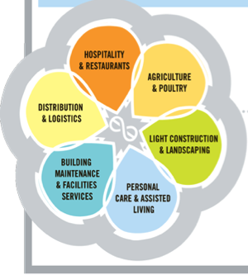

The Essential Economy
The Essential Economy Council (EEC), an Atlanta based nonpartisan organization, tapped CUI Director Jennifer Clark as an economic adviser to help develop a methodology to identify “essential economy” workers and assess their impact in the state economy.
Initial 2013 findings reveal that 25 percent of total employment in Georgia lies in these occupations.
Urban Food Systems
CUI has captured the Food Truck Movement’s transformative impact on Atlanta with their empirical analysis, and upcoming chapter in From Loncheras to Lobsta Love: Food Trucks, Cultural Identity and Social Justice.
This story of local industry adaptation and reliance of pseudo-private spaces illustrates cultural identity building, contributing to existing food trucks theory.

Slide 24
CUI Research Partners
External Partners
National Science Foundation (NSF)
Regional Studies Association (UK)
Essential Economy Council
Office of Innovation Delivery and
Performance, City of Atlanta
Office of Sustainability, City of Atlanta
City Energy Project
Portland State University, Department of
Urban and Public Affairs
University of Illinois at Urbana-Champaign,
Department of Urban and Regional Planning
University of North Carolina, Department of
City and Regional Planning
University of Virginia, The Miller Center of
Public Affairs
Georgia Tech Partners
Institute for People and Technology (IPaT)
School of Public Policy
Ivan Allen College of Liberal Arts (IAC)
Brook Byers Institute for Sustainable
Systems
Executive Vice President for Research
(EVPR)
Office of Campus Sustainability
Georgia Tech Research Institute (GTRI)
Global Learning Center (GLC)
Georgia Tech Manufacturing Institute (GTMI)
School of City and Regional Planning
School of Industrial and Systems
Engineering

Slide 25
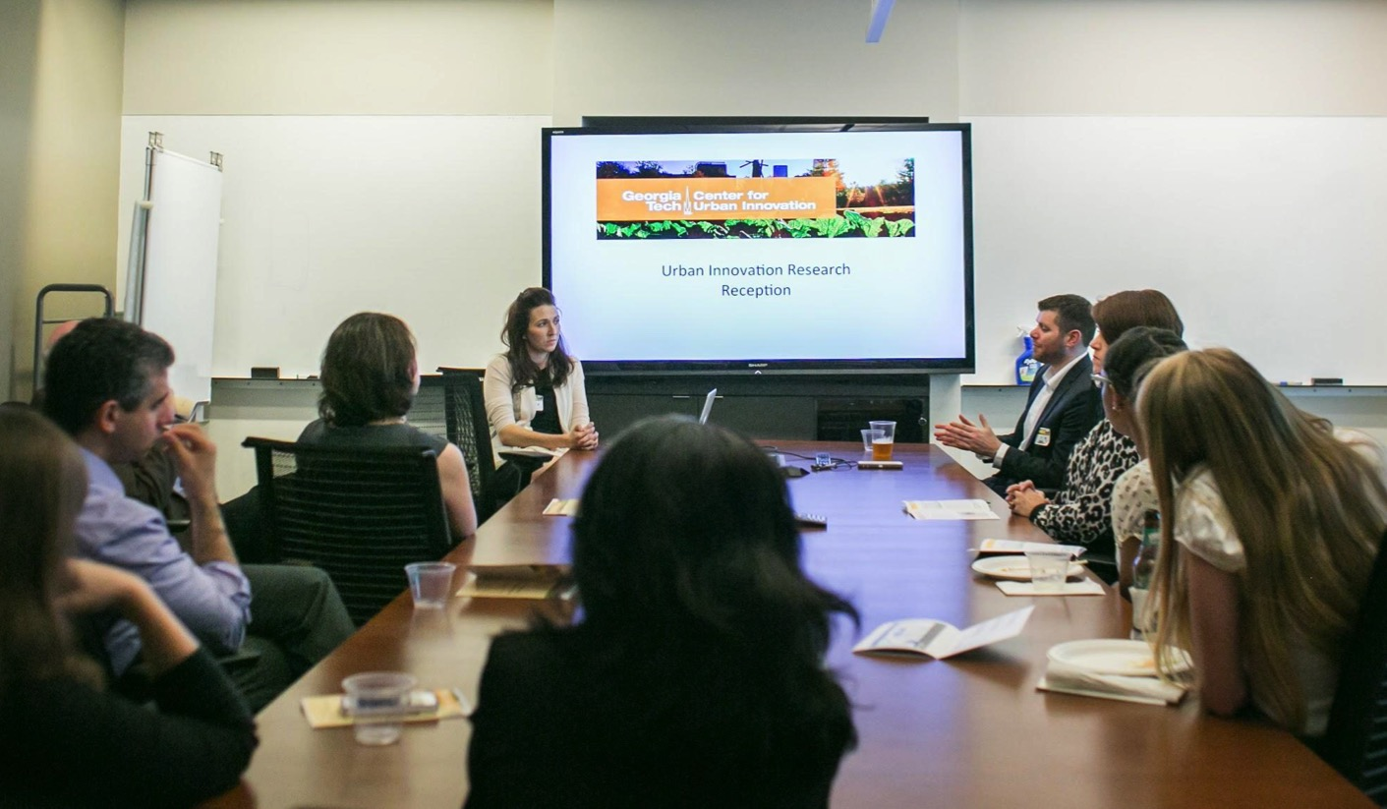
CUI is Facilitating

Slide 26
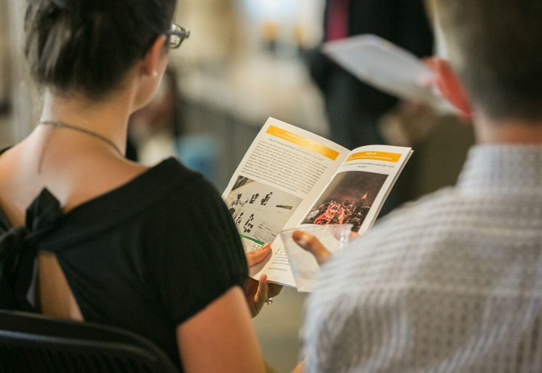
Research Showcase
Designing for Foraging
Carl DiSalvo, School of Literature, Media and Communications
Modeling Sustainable Urban Policies
Caroline Golin & Matt Cox, School of Public Policy and School of Civil and Environmental Engineering; Co-Founders of Greenlink
OneBusAway
Kari Watkins, School of Civil and Environmental Engineering
Cycle Atlanta
Christopher Le Dantec, School of Literature, Media and Communications
A Guide to the Dirty South
Jennifer Bonner, School of Architecture
Stadia Lab
Benjamin Flowers, School of Architecture
Immigrant Community Studio
Anna Joo Kim, School of City and Regional Planning
Benches and Bike Lanes
Robert Rosenberger & Caroline Appleton, School of Public Policy
Midtown Buzz
Maribeth Gandy, Institute for People and Technology; Director, Interactive Media and Technology Center; Director; Wearable Computing Center
Westside Data Dashboard
Sheri Davis-Faulkner & Katie O’Connell, Westside Communities Alliance

Slide 27
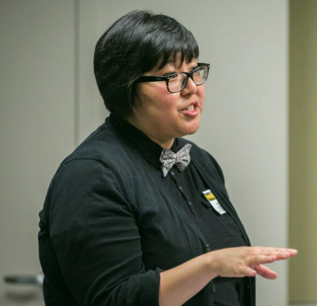
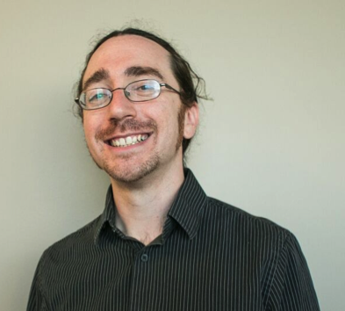
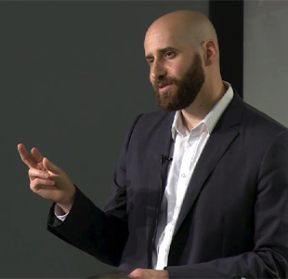
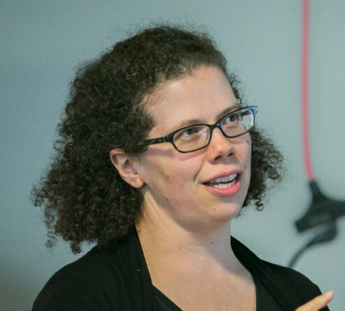
2015 Seed Grants
Immigrant Research Network
Anna Joo Kim, School of City and Regional Planning
Public Space Technologies
Robert Rosenberger, School of Public Policy
Local Data Design
Yanni Loukissas, School of Literature, Media and Communications
Co-sponsored by IPaT and GVU
Real Time Transit Control
Kari Watkins, School of Civil and Environmental Engineering

Slide 28
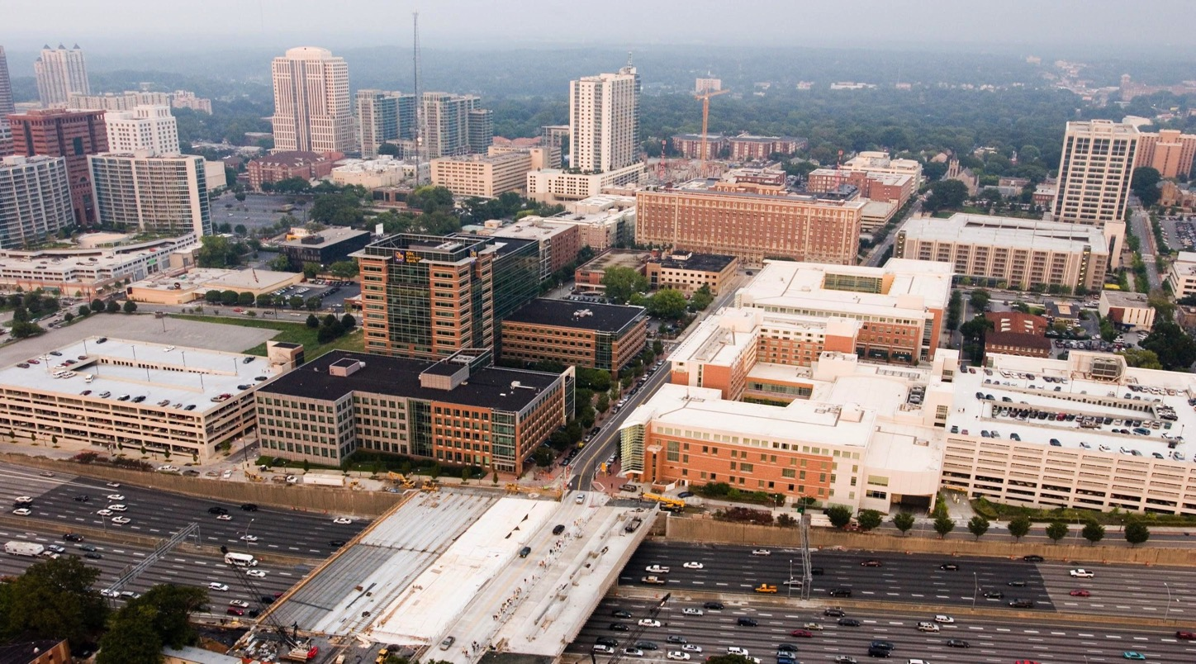
CUI is Advancing

Slide 29
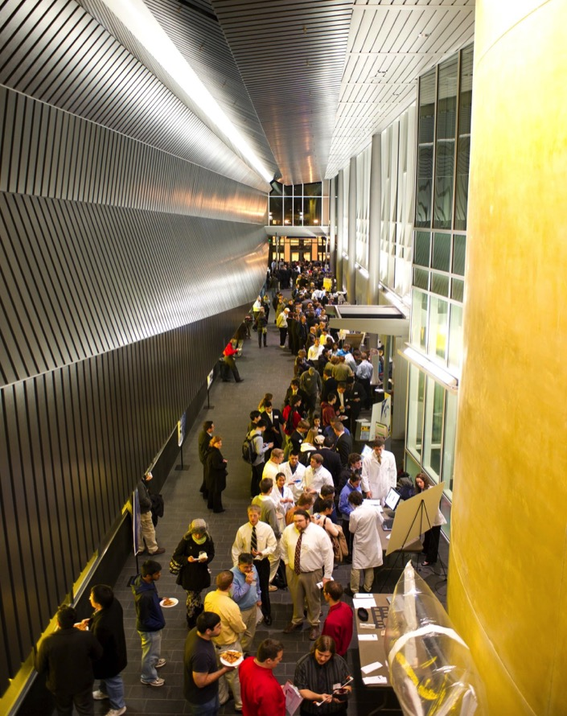
Regional Studies Association & North America Conference 2016
CUI is a research leader with the Regional Studies Association, driving the decision for the RSA to host their 2016 North America Conference in Atlanta.
International, multidisciplinary scholars will attend and CUI’s guidance will ensure participation by key Atlanta academic and civic leaders.

Slide 30

Join the
Urban Innovation Conversation
DM Smith Building
685 Cherry Street
Atlanta, GA 30332-0345
404.385.7224
urbaninnovation@gatech.edu

Slide 31
Pediatric Healthcare Delivery

Slide 32
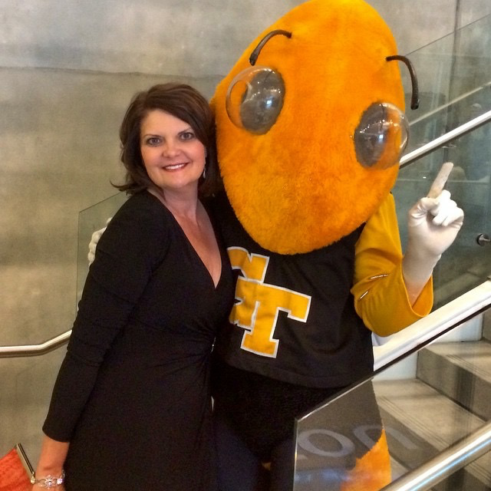
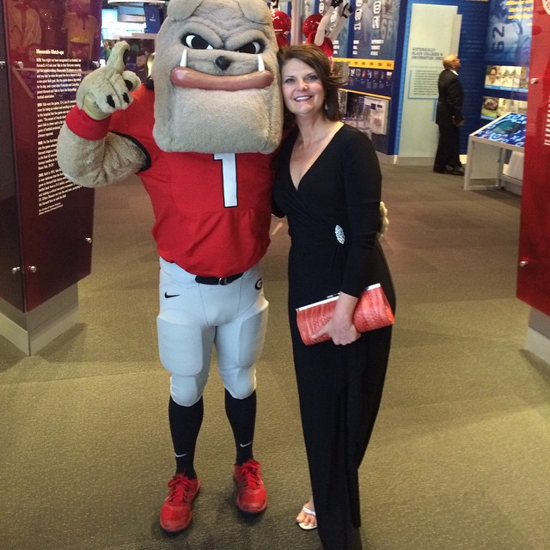

Pediatric Healthcare Delivery
Sherry Farrugia – Children’s Healthcare Annual Report

Slide 33
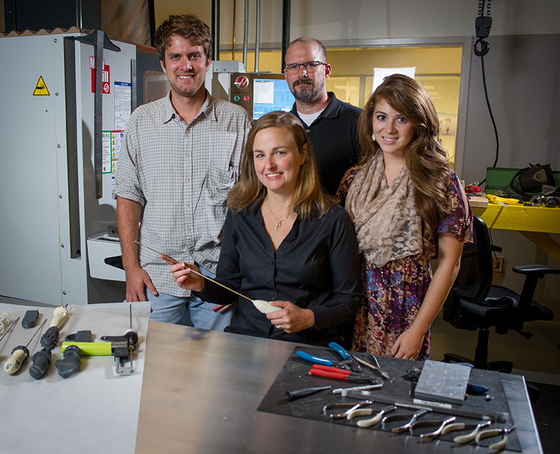
Pediatric Healthcare Delivery
Leanne West –
“Quick Wins”

Slide 34
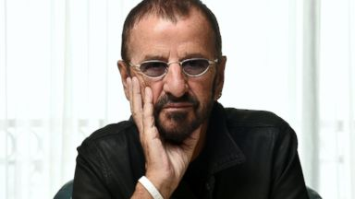
Protected Health Data Infrastructure
(Richard Starr)
New 2010-2011 CMS data for all 50 States and adding adults. Arriving soon!
If you are getting health data on campus, you need DUA and IRB approvals.
Standardizing on OMOP and OHDSI common data model and infrastructure. ( http://www.ohdsi.org )
Health Data training session Friday, October 16th. Potential topics include OMOP/OHDSI, data management plans, IRB processes.
If you have any questions or need further information, email us at phdi@gatech.edu or come see us.

Slide 35
Pediatric Research (Julie Swann)
Senior Design Groups – e.g., Children’s Healthcare of Atlanta
Several pediatric research submissions - (CDC/ Deloitte, Emory P30, Atlantic Philanthropies, etc.)
Medicaid data - posted information about Medicaid data and how to request access or collaboration to the Emory website

Slide 36




Pediatric ERC
Focus - Move the point of care from the hospital to the community/patient
Integration of devices/analytics/systems
PIs– Wilbur Lam (BME/Emory), May Wang (BME), Kevin Maher (Emory), Julie Swann/Pinar Keskinocak (ISyE) (and Sherri Farrugia and Leanne West and Megan Denham)
Dates:
  Letter of Intent – September
  NSF Pre-proposal – October
If interested…let’s talk! (pgriffin@gatech.edu)

Slide 37
Analytics For Transforming Health and Healthcare: Learning Health System

Slide 38
Analytics For Transforming Health and Healthcare: Learning Health System
Expand GT Health Analytics enterprise to encompass industry-based economic development interests:
Build viable infrastructure to enable market valued industry base and translational research
Establish product and services development and commercialization pipeline for research IP
Forge first round long-term relationships with critical industry clients by delivering and servicing our health 1st Generation analytics products and services
Reinvest sustainable GT high impact products and services revenue in scaling breadth and impact of transformative analytics products and services

Slide 39
Differentiators
Predictive and actionable versus current-state of retrospective and non-directive
  Trusted value proposition built on GT core analytics competencies:
    Visual Process Mining
      Patient Similarity
    Multi Level Simulation
    Interoperabilty
      Connecting analytics insights directly in to treatment workflows

Slide 40
Partnership and Project Examples to Date
EmployersLikeMe.org:
  To Date: GT as trusted advisor for large scale data collaborative across member companies.
  Future HPC Potential: Products and services commercialization: Data warehousing, modeling and visualization product and services development in real world transformation experimentation testbeds
UCB:
  To Date: GT as trusted designer and developer of analytics driven Epilepsy treatment guidance connected in real-time to the clinician’s workflow
  Future HPC Potential: Scalable eDecision Support platform services that transforms Pharma’s value creation in quality patient treatment

Slide 41
Humanitarian Systems
& Disaster Response
Notes:
Our current activities center around two goals: first, encouraging collaboration in our space and preparing GT to quickly understand and respond to real-world events related to humanitarian and disaster events; second theme is connecting faculty with external stakeholders to identify gaps and new joint research theme

Slide 42
Humanitarian Systems
& Disaster Response
Current Efforts:
  GT Identification of Faculty & Researchers in the Space
  Faculty and External Stakeholders Connection Seminar
Upcoming Humanitarian Events and Opportunities
Notes:
Our current activities center around two goals: first, encouraging collaboration in our space and preparing GT to quickly understand and respond to real-world events related to humanitarian and disaster events; second theme is connecting faculty with external stakeholders to identify gaps and new joint research theme

Slide 43
Humanitarian Systems
& Disaster Response
Faculty Engagement
Objective: Build upon previous efforts to identify faculty via various methods including: recommendations, self identification, profiles, research awards, pubs, external collaborations
Goal: Identify faculty across campus working in humanitarian systems/disaster response
Why:
Encourage collaboration among activities, events, proposals, etc.
Develop ability to help GT rapidly respond to events and readily assemble expertise into teams
Submit Ideas / Recommendations:
Scott.Appling@gtri.gatech.edu / Leigh.McCook@gtri.gatech.edu
Notes:
A high-level overview
This builds upon previous work to identify faculty that was originally led by Jeff Evans.
There’s going to be several ways we identify faculty
- We will be contacting schools to ask for faculty involved in this space, but we want to ask this group to send recommendations to use as well.

Slide 44
Humanitarian Systems
& Disaster Response
Faculty & External Stakeholders Seminar
Purpose
Bring together researchers working in these fields
Learn more about what we are working on
Identify areas of opportunities
Hear from stakeholders (external) to identify areas of need
Logistics
Date: Jan/Feb (TBD)
Notes:
The goal of this seminar is to encourage collaboration and to hear from our external stakeholders.

Slide 45

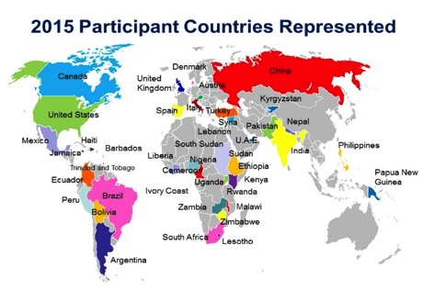
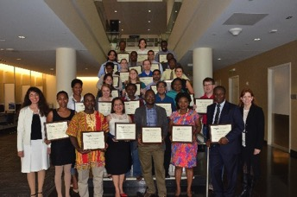
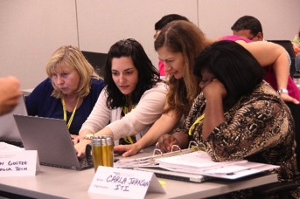
Professional Certificate in
Health & Humanitarian Supply Chain Management
hhscenter.gatech.edu/professional-education
Date: May 9-14, 2016
Courses include:
Pre-planning Strategy for Health and Humanitarian Organizations
Tactical Decision Making in Public Health and Humanitarian Response
Systems Operations in Health and Humanitarian Response
2015 participant organizations included:
AmeriCares, Boeing, Catholic Relief Services, Family Health International 360, Doctors Without Borders, Last Mile Health, MedShare, Partners in Health, Save the Children, UNICEF, UN Population Fund, USAID, World Vision, and World Food Programme.
Global reach:
HHS Center course participants to date have traveled to Georgia Tech from 18 different countries and have lived and worked in 76 countries
I have attended many humanitarian logistics trainings but this one was the best. This training provides the mathematical, statistical, technical and tactical tools which can help supply chain managers to take well calculated decisions to improve response to our beneficiaries and all other stake holders.
Dr. Mahmud Mustafa, Director of Logistics and Health Commodities at the Nigerian National Primary Health Care Development Agency
Notes:
And here are some more upcoming opportunities and events in the humanitarian space.

Slide 46



7th Annual Conference on
Health and Humanitarian Logistics
http://www.scl.gatech.edu/humlog2015/
Date: November 18-20, 2015
Location: Gordon Institute of Business Science (GIBS), South Africa
Panel topics:
Planning for and Responding to Complex Humanitarian Emergencies
Improving Public Health Systems in Developing Countries
Supply Chains for Ebola and Communicable Diseases
Infrastructure and Capacity: Begin Today to be Ready Tomorrow
Speakers include representatives from:
The Bill and Melinda Gates Foundation, Clinton Health Access Initiative, The Coca-Cola Company, Doctors Without Borders, GAVI, IMPERIAL, IMRES Medical Solutions, Johnson & Johnson, Last Mile Health, McKinsey & Co., Medic Mobile, North Star Alliance, OXFAM, People that Deliver, The Global Fund to Fight AIDS, Tuberculosis and Malaria, UNICEF, World Food Programme, UPS, USAID, UTi Pharmaceuticals, and World Health Organization

Slide 47
2015-16 HHS Center and Partner Events
hhscenter.gatech.edu/events
Aid & International Development Forum (AIDF) September 10-11, 2015
Global Disaster Relief Summit Roundtable
disaster-relief.aidforum.org/
FRANCE-ATLANTA partnership with Georgia Tech October 28, 2015
Moderator for Roundtable on “Humanitarian stakes in
sustainability and climate change adaptation”
Consulat Général de France à Atlanta
www.france-atlanta.org
IMPACT Speaker Series, co-sponsor
Georgia Tech Scheller College of Business, Institute for Leadership & Entrepreneurship (ILE)
Co-organized by Terry Blume and Dorottya Pap
www.scheller.gatech.edu/centers-initiatives/ile/impact
Bill George, Author, former chairman and CEO of Medtronic Oct 14, 2015
Lisa Borders, President, The Coca Cola Foundation Oct 28, 2015
Rebecca Curzon, Senior Program Manager
IBM Corporate Citizenship & Corporate Affairs Jan 27, 2016
Michelle Nunn, CEO, CARE USA Spring 2016, Date TBD
Randy Lewis, Author, former Vice President of Walgreens Spring 2016, Date TBD

Slide 48
Successful Aging
Notes:
Smartbathroom

Slide 49

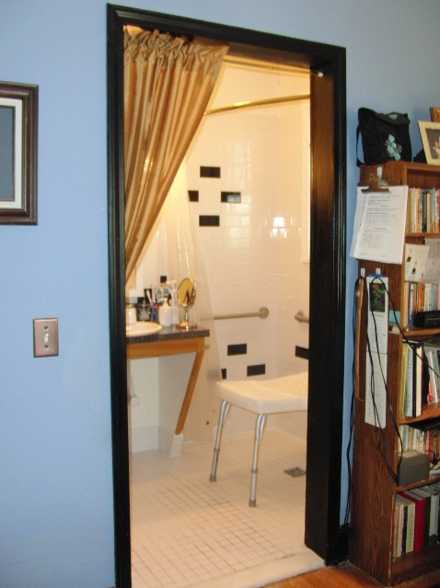
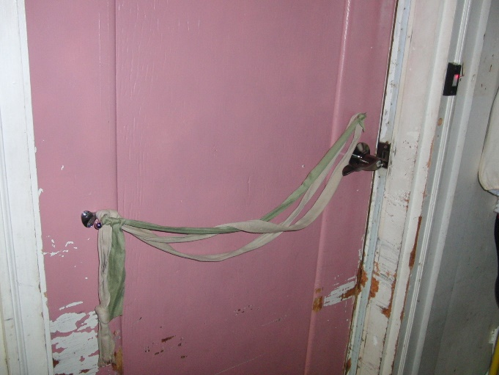
TechSAge Update
Research Projects
R1.1 Taxonomy of Everyday Support Needs
R1.2 Assess User Needs for Home-Based Activities
R1.3 Integrated RERC Dataset to Predict Task Performance and Technology Needs
Notes:
Smartbathroom

Slide 50
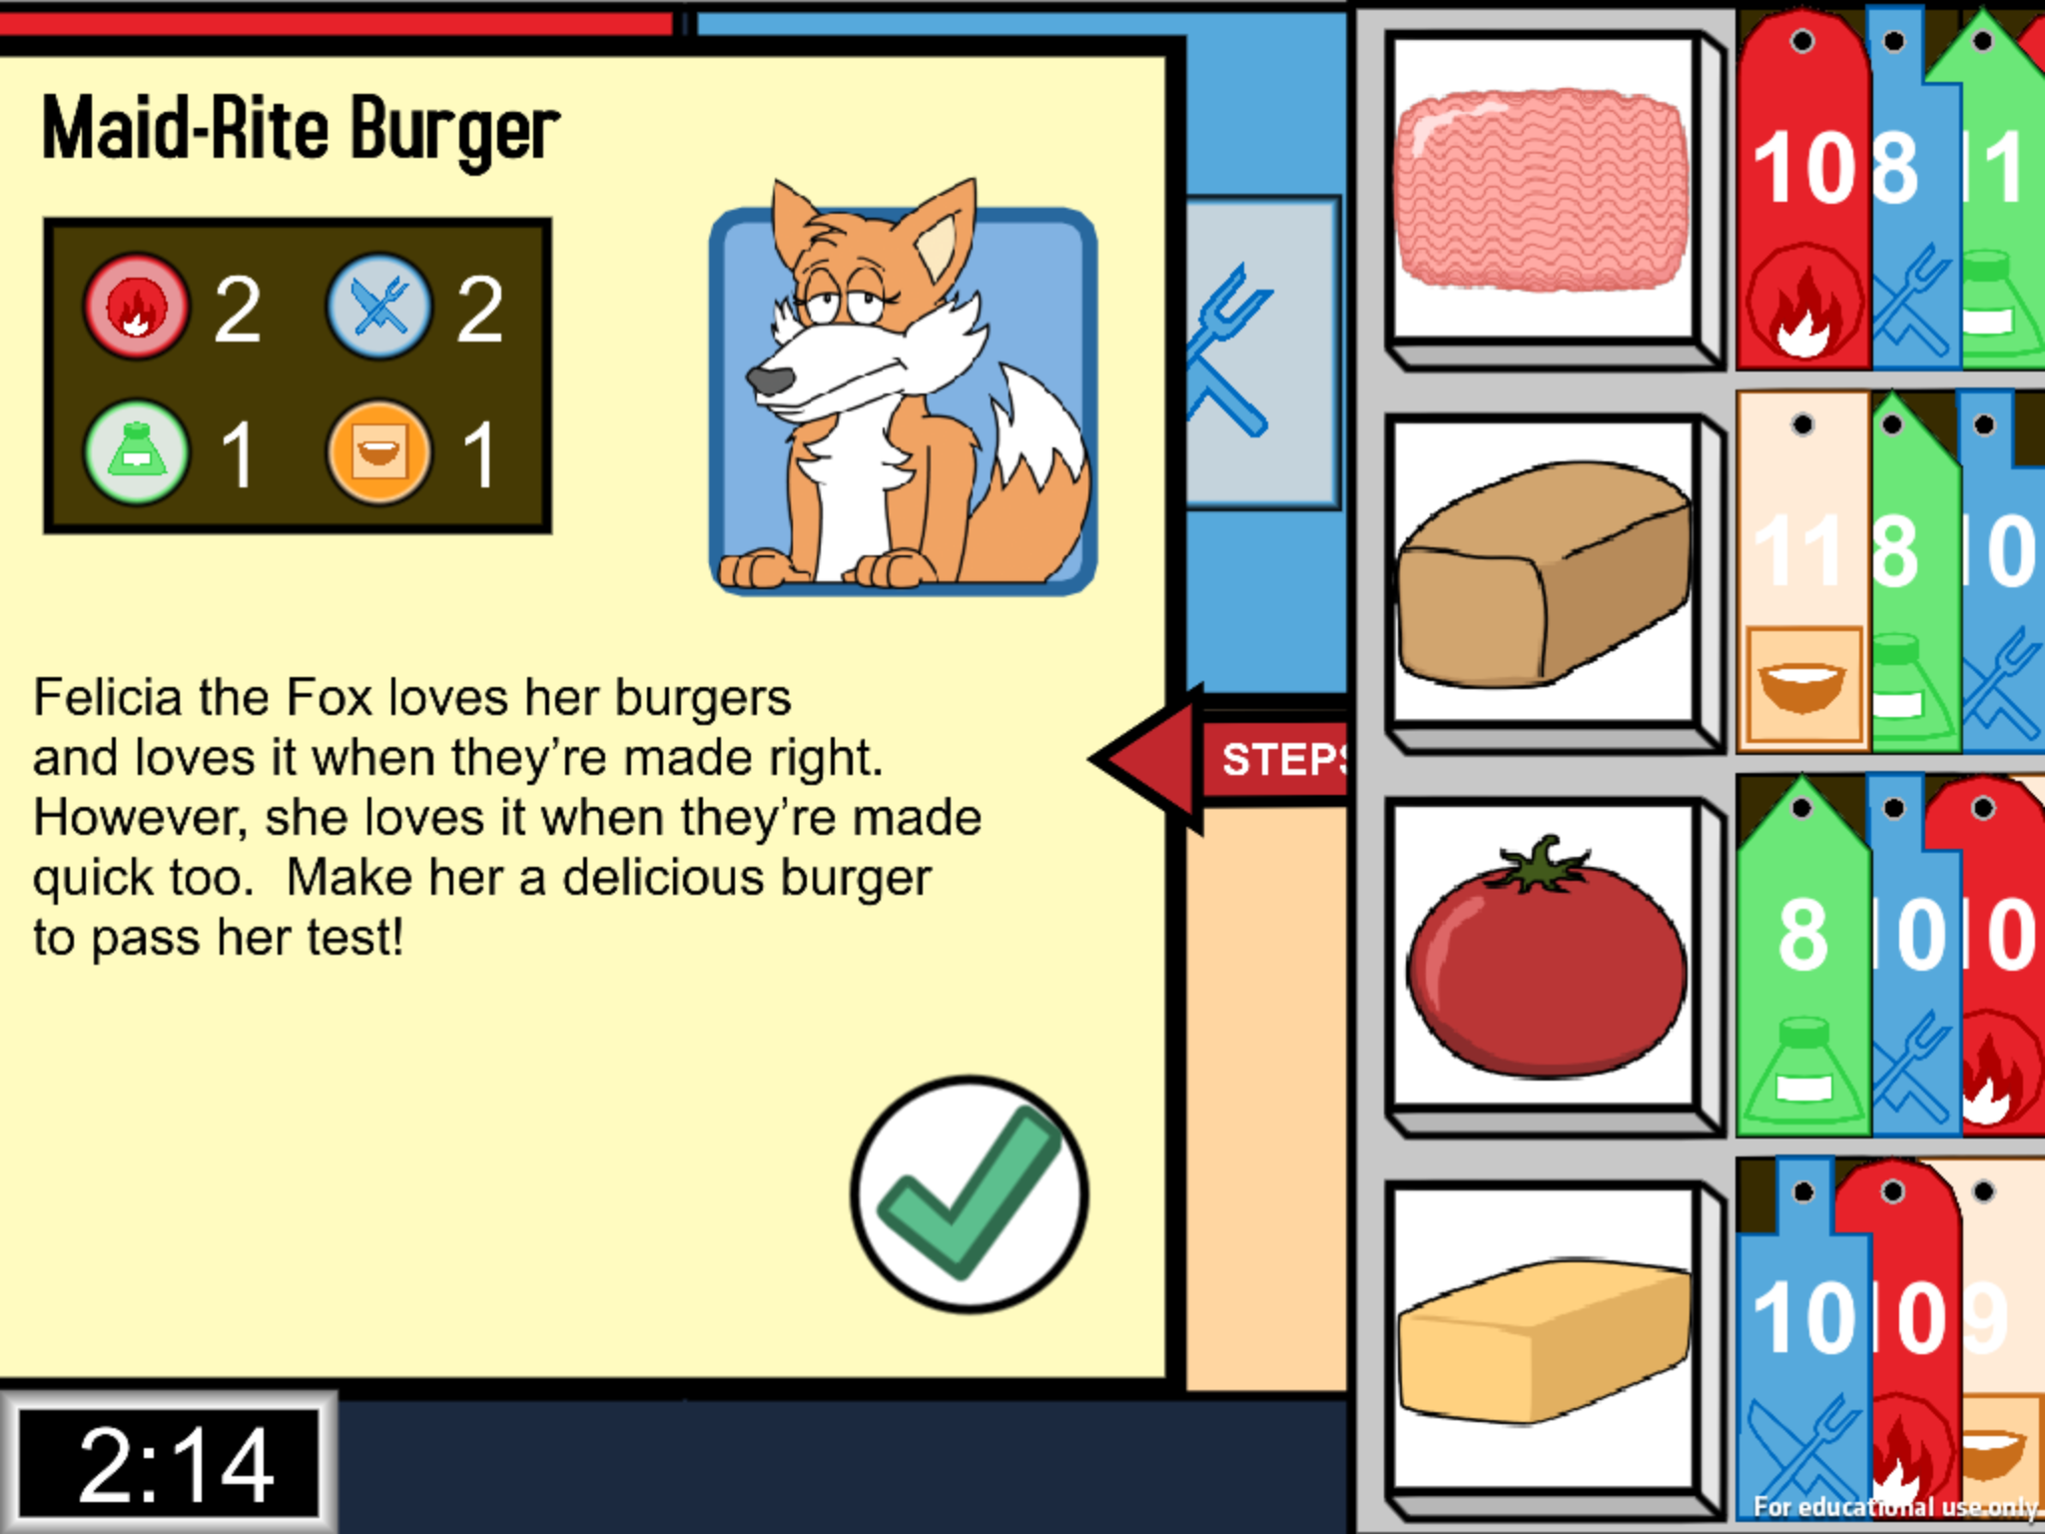
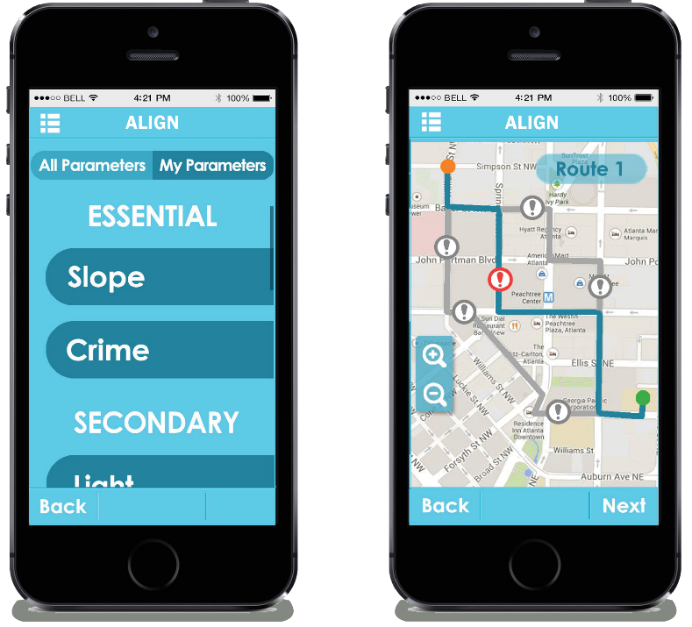
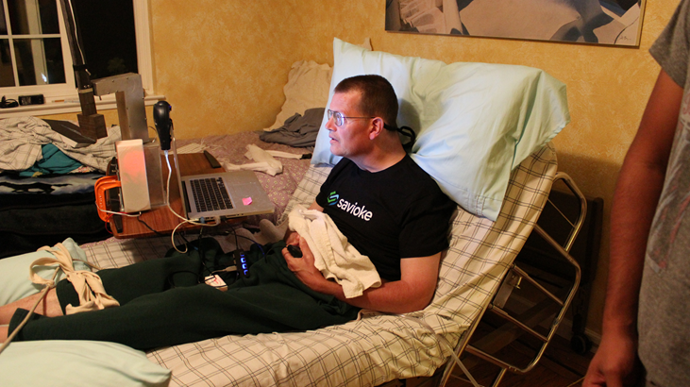
Development Projects
Apps for Aging
D1.1 Accessible Cognitive Training through Universal Design
D1.2 An App for Locational Intelligence and Geospatial Navigation (ALIGN)
D1.3 A Mobile Application to Measure Gait Speed
SmartBathroom
Mobile Manipulator Robot
Notes:
Smartbathroom

Slide 51
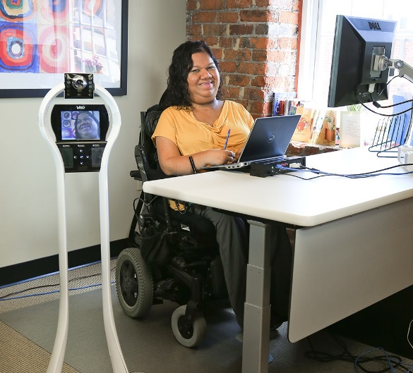
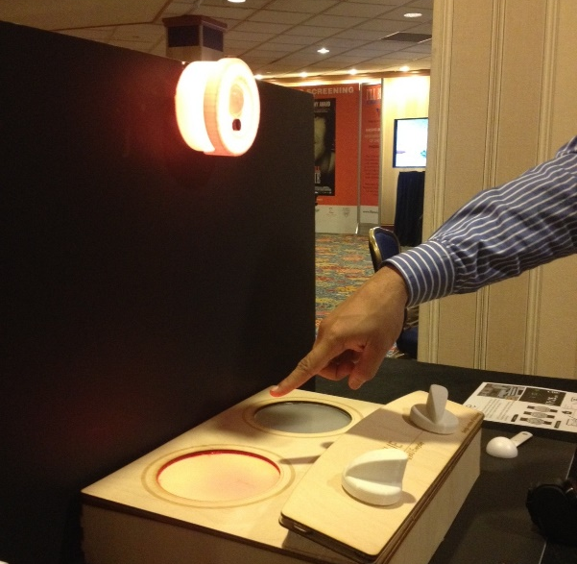
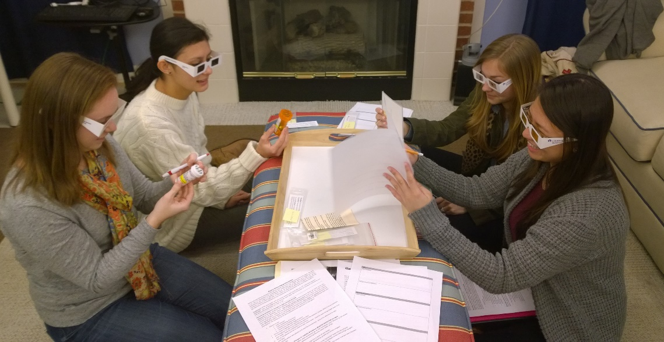
Training Projects
T1. Education in RE Research
T2. Post-Secondary Training
T3. Universal Design Competitions
  First CIC
  Next….
Notes:
Smartbathroom

Slide 52
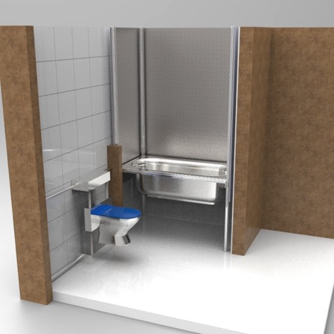
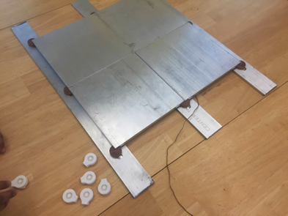
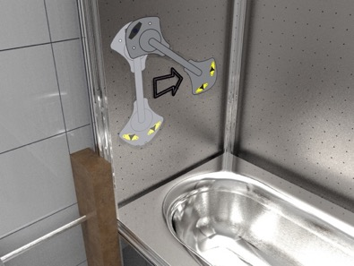
Aware Home Update
Research Projects
RERC TechSAge Smartbathroom, Gait Speed Measurement App/Device (Sanford, Jones et al)
Data to Healthy Decisions: Sleep and wake patterns (Folds et al)
Notes:
Smartbathroom

Slide 53
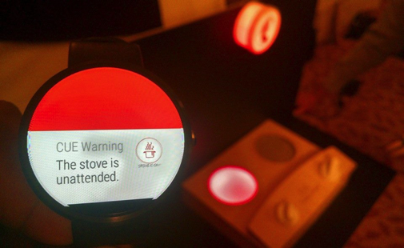
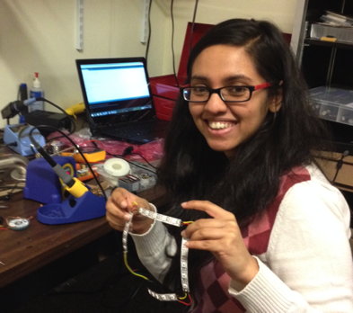
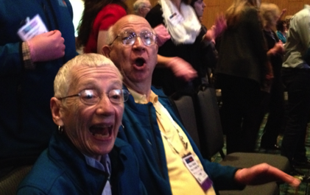
Aware Home Update
Student Engagement
Informal design sessions
CiC support
Upcoming Opportunities
LeadingAge HackFest (October 30 –
November 1, 2015 - Boston)
Technology and Aging Summit (November 12, 2015, GTRI conf center)
Notes:
Smartbathroom

Slide 54
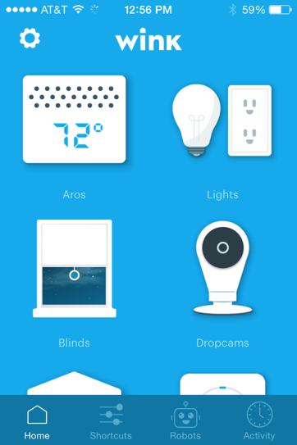

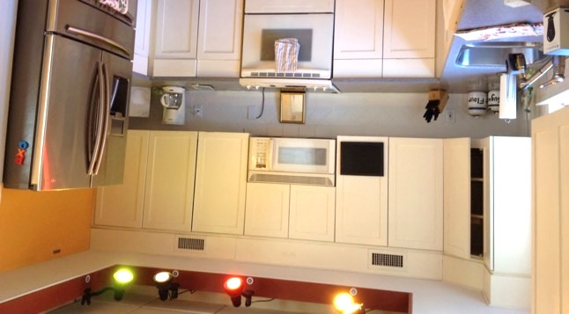
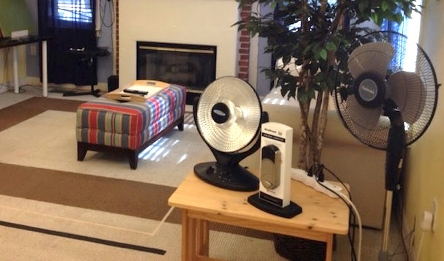
Aware Home Update
Connected Living Partners Program
Flextronics (aka Flex): integration, testing, demonstration
CiC
Define applied research, data analytics
Notes:
Smartbathroom

Slide 55

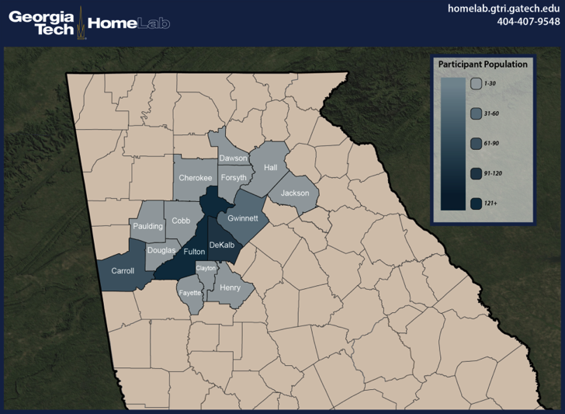
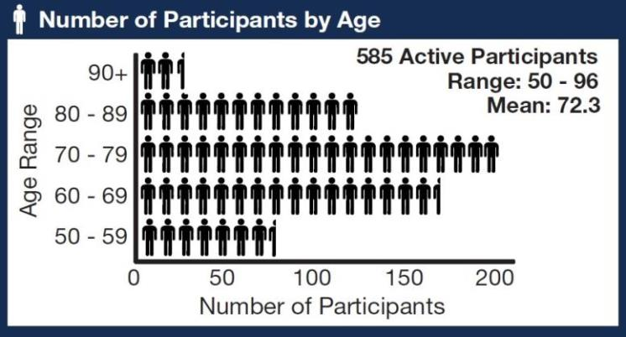
HomeLab Update
External funding at the highest level since inception
Looking for researchers interested in executing in-home research studies

Slide 56
HomeLab Update
Research Projects
TechSAge (medication adherence ethnographies)
Fiskars (human hand modeling and ethnographies)
General Mills (food packaging research)
GE Appliances (kitchen of the future ethnographies)
National Aging in Place Council (conference in December)
AARP Catalyst (activity trackers, medication adherence technologies)

Slide 57

Trackers showed promise for improving overall health with older consumers but presented some usability issues.
77%
46%
45%
reported activity and sleep trackers to be useful
said they were more active, slept better or ate more healthfully
said they were more motivated toward
healthy habits.
What did participants enjoy most
Learning their daily activity and sleep patterns
Receiving motivation by seeing progress made
toward a goal
Having their current activity levels confirmed
Finding the device to be easy to use

Slide 58

Only 42 % planned to continue to use such a device in the future
89%
39%
47%
had difficulty in device set-up process.
had some difficulty finding
the instructions
had an issue
with syncing the
device
The top 4 frustration were
Perceived inaccuracies in the data reported by the devices
Challenges in finding and using the instructions
Perceived device malfunctions, especially related to syncing
Difficulty putting on and wearing the device / discomfort

Slide 59
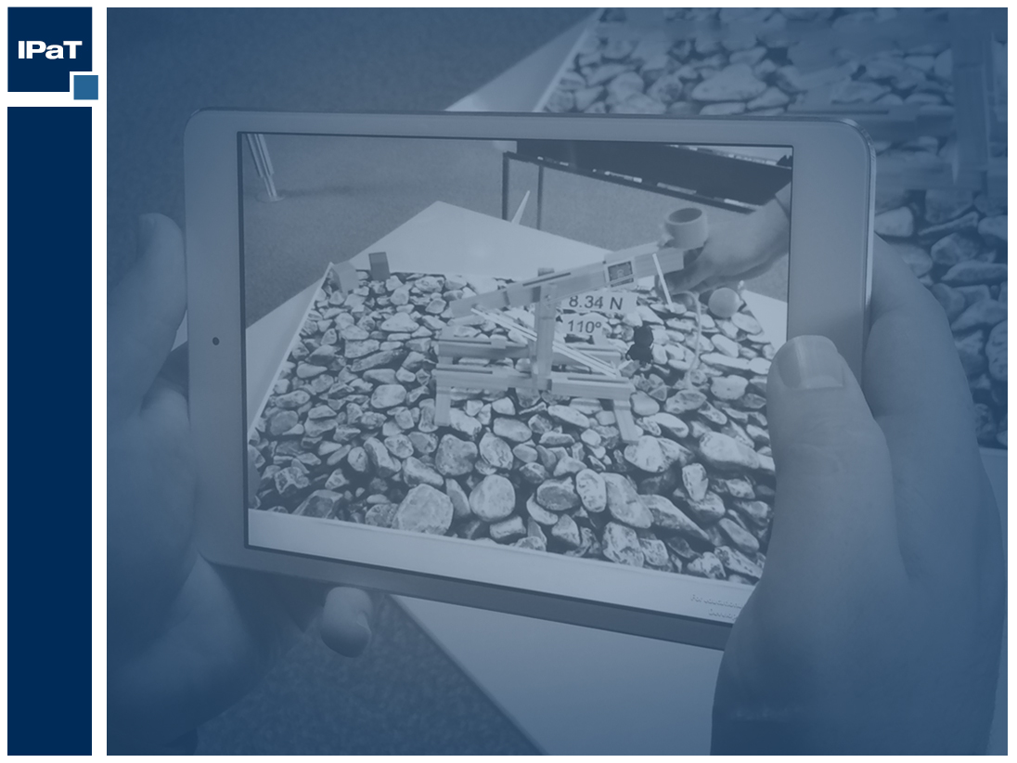
IPaT Support Team

Slide 60
IPaT’s Support Team
IMTC
RNOC
Research Operations
Industry Partners
Proposal Support
Marcom

Slide 61
Interactive Media Technology Center (IMTC)
Director: Maribeth Gandy, maribeth@imtc.gatech.edu
Associate Director: Scott Robertson, scott@imtc.gatech.edu
Fifteen Research Scientists
  Hardware design, software engineering, HCI, medicine, psychology, graphic design, game design, assistive technology, machine learning…
Research foci
  Sensing and pattern rec, health and aging, IoT, wearable computing and AR, civic computing, serious games
  Collaborators from CoC, Psych, ECE, BME, ECE, LMC, CATEA, COA, GTRI, RNOC…
Enable ambitious research around campus and amplify
the impact of IPaT
  Enable Interdisciplinary/Large projects
  Perform Engineering/PM at scale
  Participate as Research Collaborators
  Support Tech Transfer
  Provide Sustainability

Slide 62
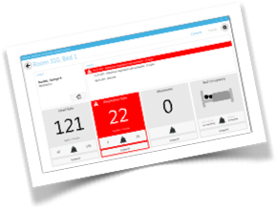
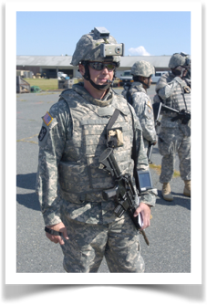









Interactive Media Technology Center (IMTC)
Director: Maribeth Gandy, maribeth@imtc.gatech.edu
Associate Director: Scott Robertson, scott@imtc.gatech.edu

Slide 63
RNOC: Mission and Capabilities
We are providing an unfair competitive advantage to GT students, faculty, and external partners
Research Neighborhoods (including Health IT)
Federated Research Infrastructure
Student Led Innovation and Production
  Fostering Entrepreneurial Confidence
  CIC, Tutorials, Device and Service Library
  AppLab (TSRB 333)
Instantiation and Operation of Living Labs
Application publishing (iOS, android, etc)

Slide 64


GT Journey
Final year of bootstrap funding
Transition to new funding model – e.g. AuxSvcs/Dining App, Buses/Parking, AppStore, Wireless, Facilities, …
Beyond Mobile, Web and API’s: IoT Smart Campus and Analytics (w/DSSG)

Slide 65
RNOC Team
Co-Directors: Russ Clark and Matt Sanders
Operations and Software Development: Brian Davidson
Industry Partnerships and Projects: Siva Jayaraman
Internet of Things Lead: Bill Eason
RNOC Lab Staff: ~15-20 students
Email us: RNOC@gatech.edu

Slide 66



IPaT Research Operations: Mission and Capabilities
Support and Empower IPaT’s Research and Innovation Enterprise
Provide support to fulfill and grow sponsored partnerships by streamlining application, data, and facilities needed for research and innovation
Operate a HIPAA Compliant IT environment (data -> knowledge -> services) for healthcare and health IT research and innovation

Slide 67
IPaT Research Operations: Team
Director: Matt Sanders (msanders@gatech.edu)
Aware Home Lab Director: Brian Jones (brian.jones@imtc.gatech.edu)
Systems Support: Paul Diedrich (paul.diedrich@gatech.edu)
Health Data Management: Richard Starr (rstarr7@gatech.edu)
With help from:
Sean Brennan (GVU)
RNOC & IMTC
OIT (PACE, Cyber Security, and Networking) & Departmental IT peers in ISYE, CoC, Engineering, etc…

Slide 68
IPaT Research Operations: 2016 Goals
Improve resiliency and scalability of research infrastructure
Expand CMS data & usage, updated DUA, and tools
Develop OMOP/OHDSI common data model
Develop better options for sustainable application deployment
Aware Home: grow number of supported projects/PIs & industry partnerships + smart bathroom & HIT showcase integration.
The cobblers children need some love - improve event and office IT support (email, a/v, calendar, shared document repository, etc)

Slide 69

Strategic Partnerships

Slide 70

The Strategic Partnerships Team
Siva Jayaraman
Caroline Gaines Wood
Ed Price
Marla Gorges
Sherry Farrugia
Laurie Baird
partners@ipat.gatech.edu

Slide 71
2015-2016 Goals
Partnership ecosystem
Ideate, Communicate, Educate, Relate
Build an anchor partner(s)
Sustained and enduring partnership
Create an IPAT engagement mode
Build a systematic way to tell the IPaT story – future & current partners
partners@ipat.gatech.edu

Slide 72
IPaT’s Proposal Support Team
Team: Ed Price (ed.price@gatech.edu),
Francine Lyken (francine.lyken@hsi.gatech.edu)
Assignment:
Provide proposal support (budgets, submission criteria, signatures, etc)
Identify key opportunities and notify the applicable faculty
Provide campus leadership on major opportunities (ERCs, P30s, other multi-project proposals)
Goals for FY16:
Be a resource to our research community they can utilize in supporting a diverse portfolio of proposals.
Submit X proposals from IPaT (at least 20 quality proposals of $1M+)
Philanthropy / Foundation Proposals

Slide 73
IPaT Marketing Communications
Renata LeDantec
Assistant Director

Slide 74




Marketing Communications & Events Team
Alyson Powell, Communications Officer
Responsible for IPaT Insider, articles, news releases, web content, social media, videography, photography, PR, information dissemination to campus
Raul Perez, Graphic Designer
Responsible for IPaT visual identity. Develops and produces designs for websites, booklets, flyers, posters, PowerPoint presentations, newsletters, events, icons, logos, signage, templates, etc.
Alex Key, Web Developer, GTRI
Expertise in Drupal and Wordpress CMS, HTML, CSS, JavaScript, and IT repair and support
Don Schoner, Event Coordinator
Manages IPaT suite and events logistics--from conferences and forums to meetups, workshops, and industry visits

Slide 75
Upcoming Events in the Suite
8/21/15 IPaT 2015 Town Hall Meeting & Networking Reception 2:30pm-6:00pm
8/25/15 VentureLab Mentor Lunch 11:00am-1:00pm
8/25/15 Children's Healthcare of Atlanta Apps Strategy 1:30pm-3:30pm
8/27/15 Barcelona Innovation in Atlanta/Jennifer Clark 8:00am-6:00pm*
8/27/15 TAG Ed STEM Education Awards VIP Reception 6:00pm-7:30pm
8/28/15 Speaking Circle 1:00pm-3:30pm
10/5-9/15 Supernova South (all over Tech Square) 10/21/15 Wearable Computing Symposium
10/15/15 Intel Innovation Award Judging WICT Event
10/16/15 Evidation Campus Visit GVU Demo Day
10/28-29/15 IPaT 5-Year Review Presentations

Slide 76
Currently Working On & FY16 Priorities
Updated Marcom Plan
New website – Launch 8/31
Templates for posters and ppt presentations for IPaT faculty
Research Digest
Tennenbaum Institute website
Marcom support of targeted initiatives for FY 2016
  Wearable Computing
  Smart Cities and Urban Innovation
  Pediatric Healthcare Delivery
  Learning Healthcare Systems
  Community Resilience and Disaster Response
  Successful Aging

Slide 77

IPaT Website Design

Slide 78
Engagement Grants

Slide 79
Promoting Cognitive Systems Research at Georgia Tech
Ashok Goel (IC) and Elizabeth Whitaker (ICL, GTRI)
Timothy Boone (ICL, GTRI), Michael Hoffmann (Public Policy), Margaret Loper (ICL, GTRI), Julie Linsey (ME), Keith McGreggor (IC), Janet Murray (LMC), Amy Pritchett (AE), Mark Riedl (IC), Eric Schumacher (Psychology), and Alan Wagner (ATAS, GTRI)

Slide 80


Cognitive Systems
Human-level intelligence, typically human-centered intelligence, and often human-like intelligence

Slide 81
A cognitive systems community
Seminar series with external speakers
Monthly meetings
Yearly workshops
Foster internal collaboration
Enhance external visibility
Big Goal: An interdisciplinary Center for Cognitive Systems!

Slide 82
Reimagining Humanities Visualization: A research-through-design workshop for civic and cultural data
Rahul Basole (IC), Polo Chau (CSE), Carl DiSalvo (LMC), Alex Endert (IC), Jim Foley (IC), Nassim Jafari-Naimi (LMC), Lauren Klein (LMC), Yanni Loukissas (LMC), John Stasko (IC),
and Jimeng Sun (CSE)

Slide 83
GT is a center for visualization research and the digital humanities.

Slide 84
Data in humanities research is fractured and messy.

Slide 85
How can we use visualization techniques and tools to explore this data?

Slide 86


Slide 88


Slide 89


Slide 90
Spring 2016 Workshop
2-days
20-30 participants
Information Designers, Visualization
Researchers & Humanities Scholars
Low-fidelity prototyping of new visualization
techniques and tools

Slide 91
IPaT Fall Town Hall
Aug 21, 2015

